Slide 1

Assessing community impact: a sample of ESIP’s activities
Karl Benedict, President
ESIP
Notes:
It is a privilege to be speak to you all today. 20 years ago the Earth Science Information Partners began as a cohort of 24 NASA funded projects that had been given the task of building a community of stakeholders in the development of NASA’s Earth Observing System Data and Information System (EOSDIS) in response to a recommendation from the US National Research Council.

Slide 2

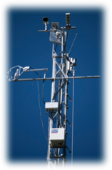





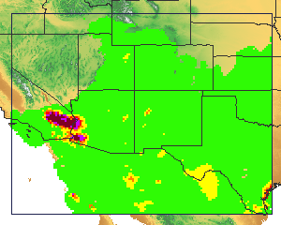


Earth Science Information Partners Vision
Leaders in promoting the collection, stewardship and (re)use
Of Earth science data, information and knowledge
that is responsive to societal needs.
Notes:
ESIP has a vision to bring distributed groups together across the data lifecycle from data providers, to researchers to application developers in order to promote the collection, stewardship use and reuse of earth science data and information. By bringing these people together they all become leaders across the field.
My focus today is on how we assess our success in achieving this vision, first at a macro level as we evaluate our impact on the community, and second as we assess our work in a specific context – ESIP’s Data Management Training Clearinghouse.

Slide 3
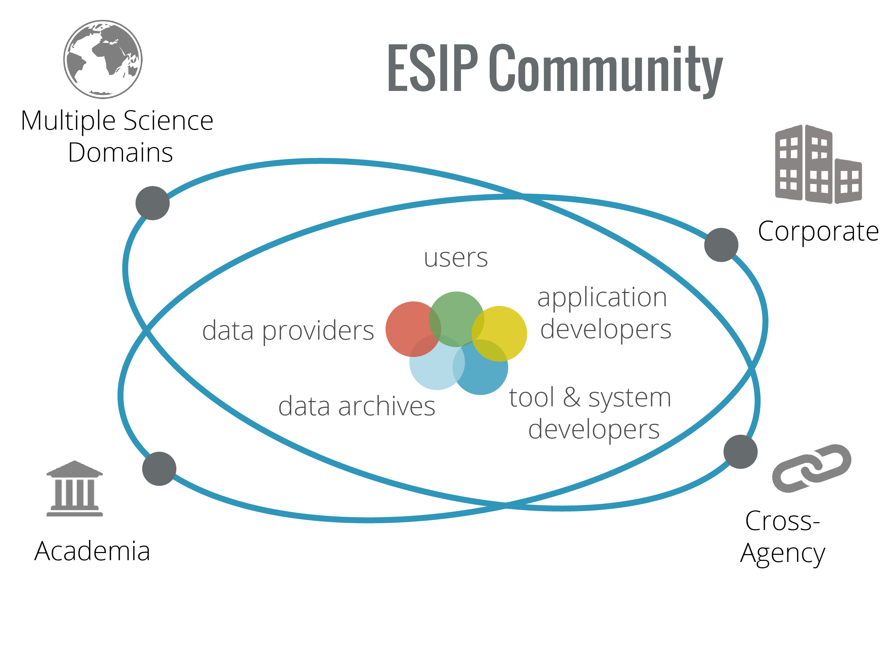




Earth Science Information Partners (ESIP)
By the numbers:
120+ Member Orgs
1000 Active Participants
30+ Working Groups
Supported by:
Notes:
For over 20 years the Earth science information partners have been bringing Earth data technologists together to ensure that those data are Findable, Accessible, Interoperable, and Reproducible (FAIR). ESIP has over 1000 active participants that space the public, private, and academic sectors. ESIP participants
Leaders in promoting the
collection, stewardship and (re)use
of Earth science data, information and knowledge
that is responsive to societal needs

Slide 4
Beyond ESIP (Just a sample)
Council of Data Facilities
ESIP
DataONE Community
USGS CDI
GEOValue Community
Notes:
What does ESIP bring to the Table – the table

Slide 5
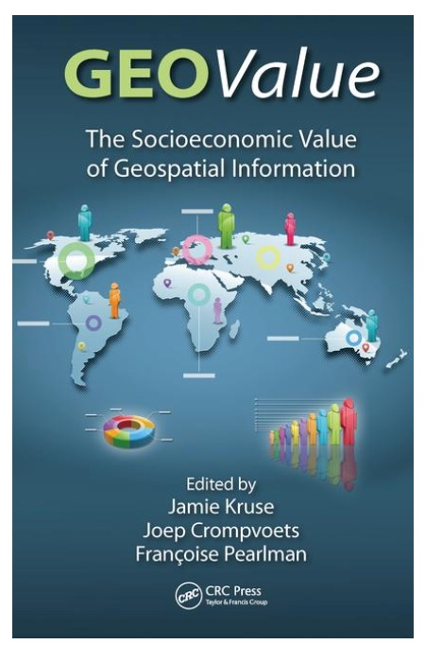
Beyond ESIP
Workshops
Webinars
Presentations
Publications
ESIP
GEOValue Community
2017
http://www.geovalue.org/workshops/
Notes:
What does ESIP bring to the Table – the table
As
Convenor
Co-convenor
Contributor

Slide 6

FAIR Guiding Principles
FAIR is…
Findable
Accessible
Interoperable
Reusable
Article in Nature journal Scientific Data: Wilkinson, M. D. et al. The FAIR Guiding Principles for scientific data management and stewardship. Sci. Data 3:160018 doi: 10.1038/sdata.2016.18 (2016).
Notes:
The current convergence towards community adoption and capacity building around the FAIR principles is a recent crystallization of the driving goals of ESIP for the past 20 years

Slide 7
There is an urgent need to improve the [Global Collaborative] infrastructure supporting the (re)use of scholarly data.
- (Modified, Erin Robinson) From The FAIR Guiding Principles for scientific data management and stewardship
Notes:
I would actually modify to say that we are making great strides in the infrastructure, but what needs help is the Global collaborative Infrastructure for use and reuse. It is connecting people and organizations together that allow for us to all move the ball forward together. And at this point we are a bit fragmented.

Slide 8
Community Impact Assessment
ESIP Strategic Goal - "Promote techniques to articulate and measure the socioeconomic value and benefit of Earth science data, information and applications."

Slide 9
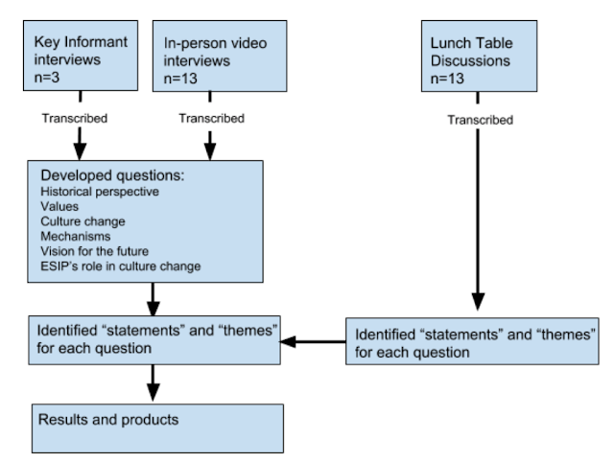
A Qualitative Approach to Assessment
2018 “Making Data Matter” Project – Dr. Arika Virapongse
Phone and Video interviews
Lunch table discussions
Results inform the 2019 ESIP Organizational Assessment approach and strategy feeding into ESIP’s next 5-year Strategic Planning project
Notes:
Why did you choose the case study? - Impact assessment for community development is difficult, but must be pursued. This case study illustrates a qualitative approach to community development assessment.
How can we effectively measure the impacts? “Measure” in the context of this qualitative approach is more aligned with identification of themes and trends to aid in characterization of impact. Less aligned with “measure” in the context of numeric metrics which we often think of when measuring.
What core indicators/models seem more appropriate to be used? Positive and negative terms around areas of intended impact. Appearance of intended impact areas in responses from interviewees.
What are the main challenges? Many Earth science researchers/technologists/data scientists do not have familiarity with qualitiative analysis methods and tools and therefore don’t employ them as frequently as quantitative tools/methods.
What works and what does not work? Qualitative data do not lend themselves towards quantitative depictions (graphs, trendlines, tables) in the way that many of us are most familiar with. Qualitative data can yield impactful statements from users that illustrate outcomes and impacts.
What are your recommended best practices? Seek out expertise in qualitative data collection and analysis to perform effective community impact assessment.
What is missing and how can this be improved? Some additional quantitative elements that can be used to assess longitudinal trends in attitudes and perceptions from community members.

Slide 10
Questions & Answers
Why did you choose the case study? - Impact assessment for community development is difficult, but must be pursued. This case study illustrates a qualitative approach to community development assessment.
How can we effectively measure the impacts? “Measure” in the context of this qualitative approach is more aligned with identification of themes and trends to aid in characterization of impact. Less aligned with “measure” in the context of numeric metrics which we often think of when measuring.
What core indicators/models seem more appropriate to be used? Positive and negative terms around areas of intended impact. Appearance of intended impact areas in responses from interviewees.
What are the main challenges? Many Earth science researchers/technologists/data scientists do not have familiarity with qualitative analysis methods and tools and therefore don’t employ them as frequently as quantitative tools/methods.
What works and what does not work? Qualitative data do not lend themselves towards quantitative depictions (graphs, trendlines, tables) in the way that many of us are most familiar with. Qualitative data can yield impactful statements from users that illustrate outcomes and impacts.
What are your recommended best practices? Seek out expertise in qualitative data collection and analysis to perform effective community impact assessment.
What is missing and how can this be improved? Some additional quantitative elements that can be used to assess longitudinal trends in attitudes and perceptions from community members.

Slide 11
Data Management Training Clearinghouse Assessment
ESIP Strategic Goal – “To increase the use and value of Earth science data”

Slide 12
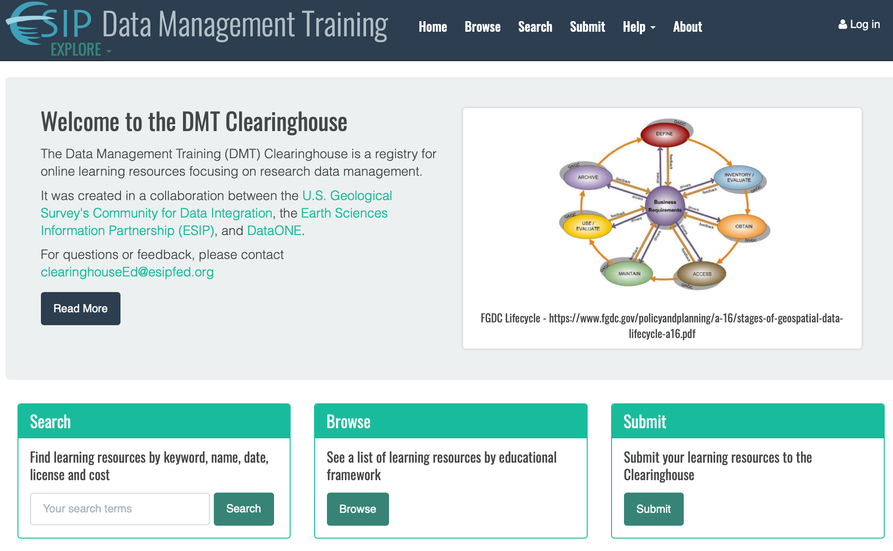
DMTC Enhancement Project
Focus on
Metadata Enhancement
Content diversification & growth
Assessment
http://dmtclearinghouse.esipfed.org

Slide 13
DMTC Assessment Directions
Focus on both the DMTC and provided content
Integration of content feedback into metadata/search informed by Kirkpatrick’s Four Levels assessment framework:
Reaction
Learning
Behavior
Results
Mixed methods
Quantitative log analytics and learning material users and learners
Qualitative feedback from users of clearinghouse and content
Guided by DMTC Assessment Working Group and Project Advisory Committee
Notes:
Why did you choose the case study? Development and delivery of quality data management training is critical for building the capacity of the Earth science community to perform high-quality work efficiently. The assessment activities around the DMTC can help close the loop on the effective discovery and use of existing training materials AND provide useful information to training material users – instructors and learners.
How can we effectively measure the impacts? Using mixed quantitative and qualitative methods.
What core indicators/models seem more appropriate to be used? Indirect (i.e. analytics) and direct (i.e. user feedback) methods of assessment information collection
What are the main challenges? Narrowing the field to the most critical areas of assessment (prioritization) and development of data collection capacity that allows for streamlined use in the system.
What works and what does not work? TBD
What are your recommended best practices? Be open to both quantitative and qualitative approaches.
What is missing and how can this be improved? TBD

Slide 14
Questions & Answers
Why did you choose the case study? Development and delivery of quality data management training is critical for building the capacity of the Earth science community to perform high-quality work efficiently. The assessment activities around the DMTC can help close the loop on the effective discovery and use of existing training materials AND provide useful information to training material users – instructors and learners.
How can we effectively measure the impacts? Using mixed quantitative and qualitative methods.
What core indicators/models seem more appropriate to be used? Indirect (i.e. analytics) and direct (i.e. user feedback) methods of assessment information collection
What are the main challenges? Narrowing the field to the most critical areas of assessment (prioritization) and development of data collection capacity that allows for streamlined use in the system.
What works and what does not work? TBD
What are your recommended best practices? Be open to both quantitative and qualitative approaches.
What is missing and how can this be improved? TBD

Slide 15
Thank you!
Acknowledgements:
ESIP is funded by NASA, NOAA & USGS
Additional DMT Clearinghouse Enhancements are funded by IMLS
Karl Benedict – president@esipfed.org, kbene@unm.edu

